Slide 1
EPR Brief Korean Experiences
June 10, 2021
Kim In Hwan,PhD
DLA, MONRE
November 22, 2019
Kim In Hwan, PhD
DLA, MONRE

Slide 2
CONTENTS
Introduction of EPR
Legal Basis for EPR
Outline of Waste Charge and EPR
Administration of EPR
How Producers Perform Duty?
Achievement of EPR

Slide 3
Introduction of EPR
Principle : Producers assume full responsibility for the whole life of products
- Pollution control and in-use safety
Extended to the end-of-life phase of products having become waste.
EPR has been first introduced in European countries
- Now, many countries adopt the scheme

Slide 4
Legal Basis for EPR in Korea
Act on the Promotion of Saving and Recycling Resources(2002)
Act on Resource Circulation of Electrical and Electronic Waste and vehicles(2007)
Waste Control Act
Waste charge system introduced in 1993

Slide 5
Outline of Waste Charge
Producer/importers pay costs for disposal
Products not easy to recycle or hazardous
containers for pesticides & hazardous chemicals
anti-freeze solutions, gum, disposable diapers, cigarettes,
non-package plastics ; not included in EPR item
Charge rate : 100% of the disposal cost
Revenue is for supporting waste disposal

Slide 6
Waste Charge Rate
Item |  |  | Charge Rate
Pesticide/Toxic |  | Plastic Container | Less 500ml; 24.9KRW/unit, above 500ml; 30.7KRW/unit
products |  | Glass Container | Less 500ml; 56.2KRW/unit, above 500ml; 84.3KRW/unit
 |  | Steel Container | Less 500ml; 53.9KRW/unit, above 500ml; 78.2KRW/unit
Antifreeze |  |  | 189KRW/liter
Chewing Gum |  |  | 1.8% of sale/imported price
Disposable diapers |  |  | 5.5KRW/unit
Tobacco |  |  | 7KRW/20 cigarettes
Plastic product | General plastic products |  | 150KRW/kg of synthetic resin input
 | Construction Plastics |  | 75KRW/kg of synthetic resin input

Slide 7
Outline of EPR
Mandate producers to burden collecting & recycling obligation(2003)
Pay a fee equal to cost of recycling
Fee serves for collection and recycling
Financial flows are managed by a PRO, not by government
Public agencies supervise the PRO

Slide 8
Administration of EPR
Target items is defined by the Acts
MOE publish mandatory recycling rate of EPR items every year
Sanctions in case of non-compliance
Impose recycling cost plus 30% surcharge
Supervision is commissioned to KECO

Slide 9
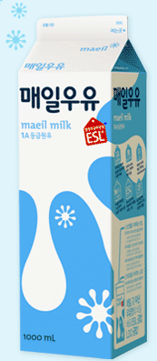
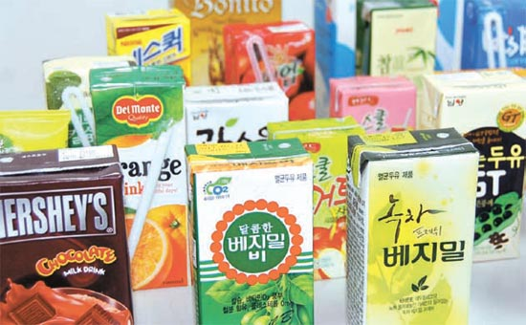
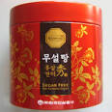
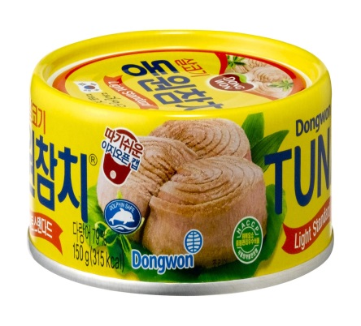
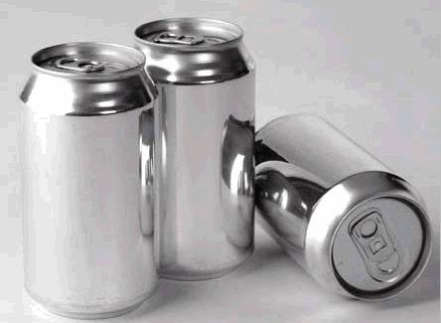
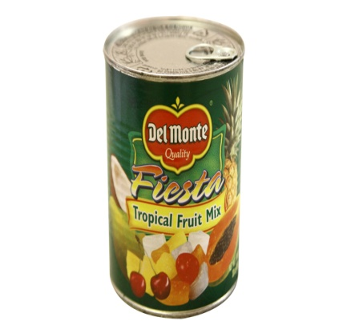
Target Item : Packaging(4)
Carton-packs
Glass Bottles
Metal cans(iron)
Metal cans(Aluminum)

Slide 10
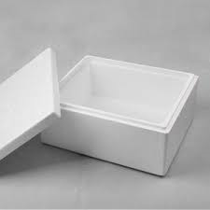
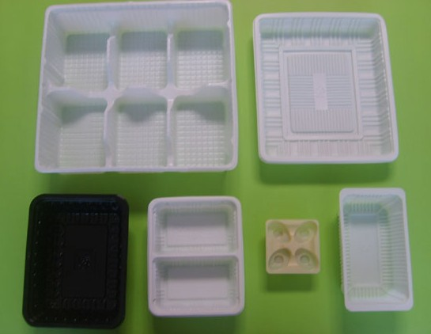
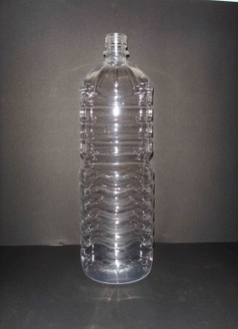
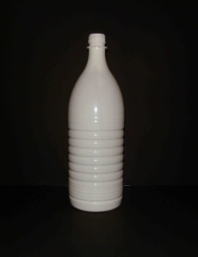
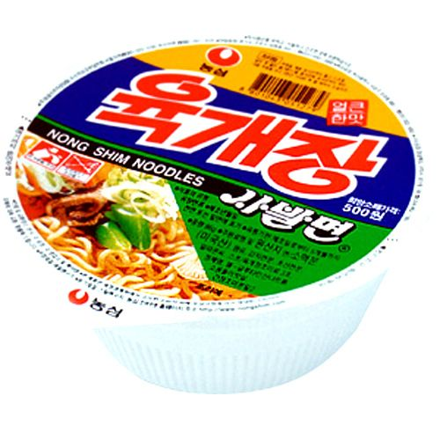
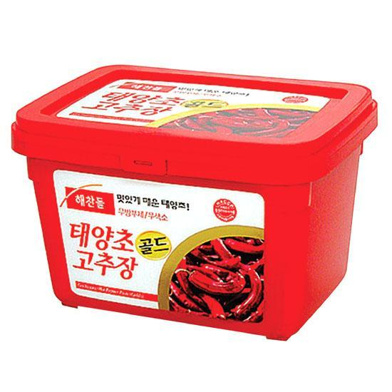
Target Item : Packaging(4)
Foamed Plastics
(EPS)
Polyvinyl Chloride
(PVC)
PET-bottle
Colorless
Color
Mix
PolyStyrene Paper
(PSP)
Others
Plastic Package for lubricant
Bottle,Tray
(PE,PP,PS)
Vinyl (others)

Slide 11
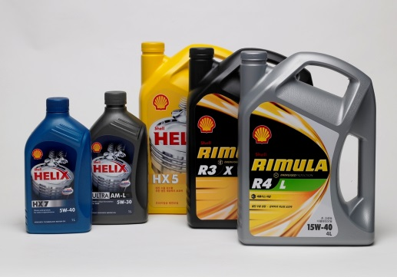
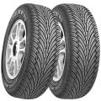
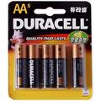
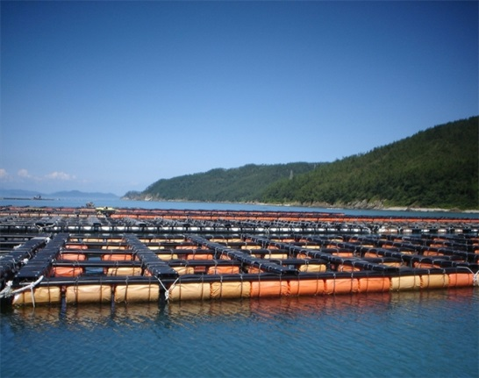
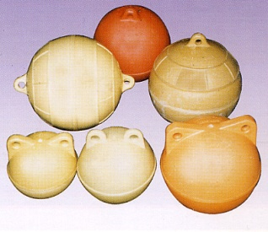
Target Item : Products(12)
Lubricant(ℓ)
Tire(kg)
Fluorecent lamp(EA)
Battery(g)
Styrofoam Float (EA)

Slide 12
Target Item : WEEE
Target products; 27 types
Large; TV, refrigerator, wash machine etc.
Communication devices; computer, mobile phones etc.
Medium-sized; electric oven, electric stove
Small; electric cooker, iron, fan

Slide 13
Target Item : ELV
Target Item;
Passenger motor vehicles
Passengers & freight motor vehicles(9 person)
Freight motor vehicles of compact and small
Observation of the recycling rate
Manufacturers/importers of vehicles
motor vehicle scrapping business operator
automotive scrap recycler
automotive shredder residue recycler
Waste gas treatment business operators

Slide 14
Mandatory Recycling Rate
Item | 2014 | 2015 | 2016
Paper Pack | 0.346 | 0.348 | 0.350
Glass Bottle | 0.760 | 0.763 | 0.763
Metallic Can | 0.791 | 0.797 | 0.797
PET | 0.812 | 0.818 | 0.818
EPS | 0.790 | 0.795 | 0.807
PSP | 0.423 | 0.423 | 0.423
PVC | 0.690 | 0.765 | 0.735

Slide 15
Recycling Method & Standard
Item | Recycling Method & Standard
Paper pack | Paper product, Recycled material, Export
Glass Bottle | Reuse, Glass powder(Recycle, Use of construction), Export
Metallic can | Reuse, Compressing for making recycled material. Export
PET | Reuse, Recycled product or material, Export (less than 20% of amount of PET bottle recycled)
EPS | Reuse, Recycled product/material, Fireproof product, Export
Synthetic resin packing | Reuse, Recycled product or material, Extract oil/ gas, Solid Refuse Fuel, Export

Slide 16
How Producer Perform duty?
Direct recovery and recycling or
Direct contract to recycling business or
Join PRO by paying contribution fees
PROs are authorized by MOE to perform recycling obligations
PROs cosign contract with recycling firms

Slide 17
Achievement of EPR
Total amount of recycled; 72% increase
1,047,000 ton(2003) ▶ 1,675,000 ton(2016)
93% of Plastic packages were recycled (2016)
Recycling business has been growing
9,769 jobs are created (2003-2012)

Slide 18
Thank you!

