Slide 1
EPR NATIONAL PLATFORM
Packaging Industry Group
Packaging Experts Teams Preparation Works
23 April 2021
(English Version)

Slide 2
Extended Producer Responsibility (EPR) concept
Extended Producer Responsibility is a concept that leverage life-cycle thinking and encourages approaches towards sustainable circular economy
EPR is a policy approach under which producers are given a significant responsibility for the treatment or disposal of post-consumer products.
Implementing EPR in Vietnam has the objectives to:
minimise the waste pollution potential of products
stimulate the recovery and the development of a market for secondary materials
The proposals contained in this presentation are based on business experiences in Vietnam and aim to contribute to the development of an EPR scheme that should be performant, progressive, and manageable.

Slide 3
3 Key Questions 🡪 3 Taskforces (revised presentation order)
Propose recycling standard specifications for packaging (Hoang Duc Vuong)
Propose list of packaging materials
Determine current recycling standards
Propose EPR target recycling standards
Propose implementation timings
Recommend recycling rates for products & packaging (Do Thai Vuong)
Determine methodology and propose current recycling rates as starting point
Propose EPR recycling rates targets for the future years
Propose implementation timings
Propose levels of contributions (Fausto Tazzi)
Propose contribution to Vietnam Environmental Protection Fund (case of not recycling by companies or through Producers Responsibility Organizations)
Propose implementation timings

Slide 4
Technical Experts Team
Leader: Fausto Tazzi (Vice Chairman of PRO Vietnam - GM of La Vie – Nestle Waters Vietnam)
Co-Leader: Do Thai Vuong (Vice President Sustainable Business & Communication – Unilever)
Co-Leader: Hoang Duc Vuong (Chairman of Regenerated Plastic Branch – VPA)
Carton paper packaging: Hoang Trung Son (Vice Chairman of Vietnam Pulp & Paper Ass.)
Metal & Glass packaging: Dang Thanh Tan (Member of PRO Vietnam – Executive VP Operations Suntory/Pepsico)
PET packaging: Reyan Sulit (Member of PRO Vietnam Technical Committee – SC Director Vietnam & Head of SC Indochina URC)
PET packaging: Lê Anh (Member of PRO Vietnam - Vice President Duy Tan Plastics)
Plastic laminates packaging: Anand Jakati (Member of PRO Vietnam - Manufacturing & Supply Chain Director Mondelez)
Plastic laminates packaging: Bruno Fux (Ecocycle & Sustainable Development Director - INSEE Ecocycle / Siam City Cement Vn)
Plastic products: Huynh Thi My (General Secretary of VPA)
Plastic resins: Mai Thi Uyen (South East Asia Sustainability Director – DOW)
Multi-materials packaging: Ly Thi Quynh Trang (Member of PRO Vietnam Technical Committee – Sustainability Director Tetra Pak VN)
General Advisors: Nguyen Duc Quang, Le Thu Hoa (Hanoi Sci&Tech University - National Consultants of DLA MONRE)
General Advisor: Prof. Nguyen Hong Quan (Director of ICED - Institute for Circular Economy Development - VNU HCM)
General Advisor: Fanny Quertamp (Senior Advisor Vietnam - EU / Rethinking Plastic)
General Advisor: Allison Lin (Member of PRO Vietnam EPR Taskforce – Public Affairs Director Asia-Pacific Tetra Pak)
Fees Advisor: Casper Durandt (Consultant of PRO Vietnam - Sustainability Director Asia&Pacific Coca Cola)
Notes:
Assoc. Prof. Dr.-Ing. Nguyen Hong Quan
Director, Institute for Circular Economy Development (ICED)
Vietnam National University - Ho Chi Minh city (VNU - HCM)

Slide 5
Reminder
Article 54. Responsibility of producers and importers for recycling
1. Producers and importers of recyclable products and packages must recycle them according to the mandatory recycling rate and specifications, except for products and packages exported/temporarily imported or produced/imported for research, learning or testing purposes.
2. The producers and importers specified in Clause 1 of this Article are entitled to recycle products and packages adopting one of the following methods:
a) Organize recycling of products and packages;
b) Make a financial contribution to the Vietnam Environment Protection Fund to support recycling of products and packages.
3. The producers and importers specified in Clause 1 of this Article shall register their recycling plans and submit annual reports on recycling results to the Ministry of Natural Resources and Environment, except for the case in Point b Clause 2 of this Article.
4. The financial contribution and use of financial assistance in recycling of products and packages specified in Point b Clause 2 of this Article shall adhere to the following principles:
a) The financial contributions and financial assistance in recycling are determined according to the quantity or unit of products/packages;
b) Financial contributions are used to support the recycling of products and packages specified in Clause 1 of this Article;
c) The receipt and use of financial contributions must be carried out in a public and transparent manner and for intended purposes in accordance with law.
5. The Government shall elaborate and introduce a roadmap for implementation of this Article.
Article 55. Responsibility of producers and importers for waste collection and treatment
1. The producers and importers of products and packages which contain toxic substances, are difficult to recycle or cause a difficulty in collection and treatment must make a financial contribution to support the activities mentioned in Clause 3 of this Article, except for products exported/temporarily imported or produced/imported for research, learning or testing purposes.
2. The producers and importers specified in Clause 1 of this Article shall make a financial contribution to the Vietnam Environment Protection Fund; the financial contributions shall be determined according to the quantity or unit of products/packages.
3. Activities supported by the Vietnam Environment Protection Fund include:
a) Collecting, transporting and treating domestic solid waste generated from households and individuals;
b) Researching and developing technologies, techniques and initiatives for domestic solid waste treatment;
c) Collecting, transporting and handling packages containing agrochemicals.
4. The receipt and use of financial contributions must be carried out in a public and transparent manner and for intended purposes in accordance with law.
5. The Government shall elaborate this Article.

Slide 6
Classification of the materials is function of 3 factors
Find the good balance between Effectiveness (each material is distinct) and Efficiency (cluster some materials to create a system simple enough at start)
In function of how much each material satisfies the conditions of:
Recyclability: how much the material is technically recyclable in Vietnam, today 🡪 RECYCLABLE (art. 54) vs. HARD TO RECYCLE (art. 55)
Collection for Recycling: how much there are infrastructures & technologies to collect the material and send it to recycling plants in Vietnam, today 🡪 RECYCLING TARGETS
Circular Economy: how much the collection for recycling can generate a sustainable circular economy model in Vietnam, today 🡪 EPR FEES

Slide 7
An effective product list is function of 3 variables
PACKAGING MATERIAL | RECYCLING PROCESS | SEGREGATE COLLECTION | RECYCLED VALUE
1.1. Paper & Carton | Easy | Existing | Medium
1.2. Beverage Cartons | Medium | To be scaled-up | Medium
2.1. Aluminum | Easy | Existing | High
2.2. Iron & Other metals | Easy | Existing | Low
2.3. Tin | Easy | Existing | Very High
3.1. Rigid PET | Easy | Existing | High
3.2. Rigid HDPE, LDPE, PP, PS | Easy | Existing | Medium
3.3. Rigid EPS, others | Medium | To be scaled-up | Low
3.4. Rigid PVC* | Medium | To be scaled-up | Low
3.5. Flexible Mono-material | Medium | To be scaled-up | Low
3.6. Flexible Multi-material** | Hard | To be created | Low
4.1 Glass | Easy | Existing | Low
* Consider to ban in future / ** Promote switch to mono-material // if “contaminated” (e.g. chemical, lubricants) packs must go in Art 55

Slide 8
Recommended product list
1ST DRAFT EPR DECREE | NATIONAL PACKAGING GROUP RECO
G.1. Paper-based packaging | 1.1. Paper & Carton 1.2. Beverage Cartons
G.2. Metal packaging | 2.1. Aluminum 2.2. Iron and other metals 2.3. Tin
G.3. Synthetic resins packaging | 3.1. Rigid PET 3.2. Rigid HDPE, LDPE, PP, PS 3.3. Rigid EPS and other polymers 3.4. Rigid PVC 3.5. Flexible Mono-material 3.6. Flexible Multi-material
G.4. Glass packaging | 4.1 Glass
Introduce more eco-modulation (e.g. colors, quantities, etc) in Step2

Slide 9
A simple, practical and effective approach at start
1. Drop differentiation of use (Food & Beverage vs Detergent, Cosmetics, Pharmaceutical): even if there are some differences in decontamination needs, better to keep simple at start and eventually insert this variable later
2. Drop distinction on pack capacity, focus on fee per ton/kg:
simpler system of measurement and control,
B. avoid loopholes for “smart avoidance” (e.g. 299ml),
C. avoid to push for smaller formats with even higher pack/content ratio
1ST DRAFT EPR DECREE
G.1.1. Food and beverages using containers made of paper-mixed based materials with a capacity of more than 100 ml.
G.1.2. Food and beverages using metal containers with a capacity of more than 300 ml.
G.1.3. Food and beverages using synthetic resin containers with a capacity of more than 300 ml.
G.1.4. Food and beverages in glass bottles with a capacity > 300 ml.

Slide 10
Recommended recycling specifications (1/2)
GROUP | MATERIAL | RECYCLING SPECIFICATIONS
G.1. Paper-based packaging | 1.1. Paper & Carton | Recycle into pulp & paper
 | 1.2. Beverage Cartons | Separate fibers & poly-aluminum, then recycle separately
G.2. Metal packaging | 2.1. Aluminum 2.2. Iron 2.3. Tin | Recycle metal
G.3. Synthetic resins packaging | 3.1. Rigid PET 3.2. Rigid PE, PP, PS 3.3. Rigid EPS, others 3.5. Flexible Monomaterial 3.6. Flexible Multimaterial 3.4. PVC | (detail in next chart)
G.4. Glass packaging | 4.1 Glass | Color classification (manual), crush, separate from paper and plastic, optical color separation, then grind for glass recycling or crush for aggregate
Need guidelines to ensure environmental sustainability / controlled emissions

Slide 11
Recommended recycling specifications (2/2)
GROUP | MATERIAL | RECYCLING SPECIFICATIONS
G.3. Synthetic resins packaging | 3.1. Rigid PET | Color classification (manual/optical), peeling labels, density separation, removing impurities, shredding, grinding, pelletizing by extrusion / blow molding / injection molding
 | 3.2. Rigid PE, PP, PS
 | 3.3. Rigid EPS & others | Recycling or energy recovery (depends on facilities)
 | 3.4. Rigid PVC | Harmful material, pollutes the separation process of other plastics
 | 3.5. Flexible Monomaterial | Extrusion, molding
 | 3.6. Flexible Multimaterial | Density separation, hotpress OR energy recovery
Recycle according to the following circular packaging economy priorities:
Food grade plastic products
Non-food grade plastic products &/or Fibers
Chemical production
Preprocessing, use as alternative fuel with energy recovery, recycle mineral
(NOTE: need clear position on bioplastics/compostable, that can pollute the recycling system)

Slide 12
Recycling rates determination in Vietnam
HANOI SCIENCE & TECHNOLOGY UNIVERSITY
R_{A}=D*T*P
R_{A} is actual recycling rate,
D: Discarding coefficient, related to lifespan of product (L), and discarded rate from household (D_{R}). D = L*D_{R}
T: Take-back coefficient, related to recovery rate of from collection system. T: 0.1 – 1.0
P: Product recycling coefficient related to available recycling technology. P: 0.1 – 1.0
CHALLENGES & PROPOSED SOLUTIONS
Feed the formula with real data 🡪 Year 0 to fine-tune the system. Under MONRE coordination of methodology of study, each material flow shall launch deeper research to capture Vietnam’s reality
Theorical Recycling Rate vs. Auditable Recycling Rate. Theorical recycling rate is different from Auditable recycling rate: not all what is collected today can be traced & audited by an EPR system (informal sector participates to theorical calculation of collection rate, but today cannot be traced and audited) 🡪 Insert a discount factor to capture only the auditable collection rate, use Year 0 to fine-tune the system. Then progressively integrate informal sector in the system
Urban/Rural (Location of Recycling facilities & Logistic constraints)🡪 insert in the formula a ‘discount’ factor at start to focus targets on urban areas at the beginning

Slide 13
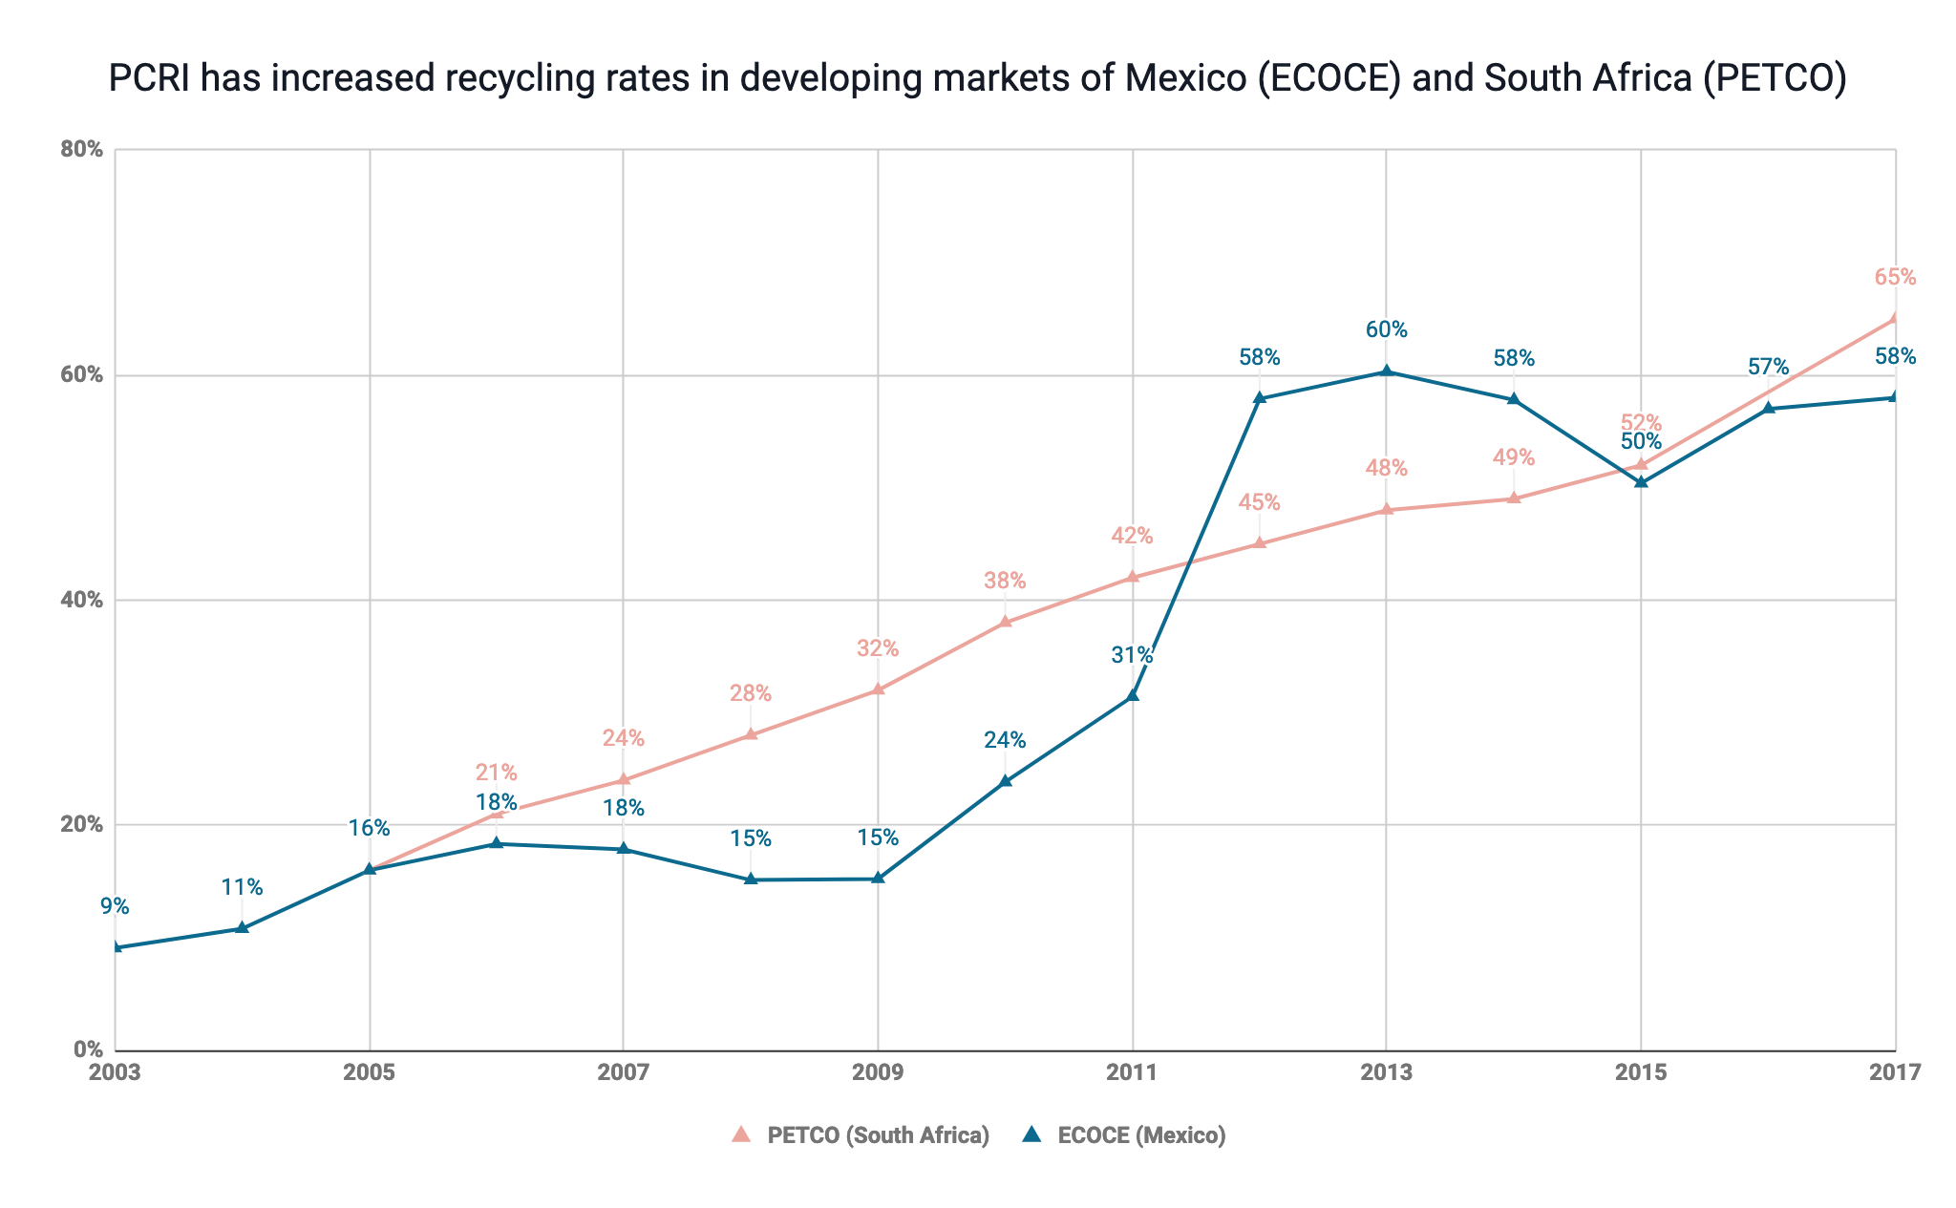
Achieving high recycling rates takes time
Price incentive removed
Price incentive continues
ECOCE set-up, Negotiations for price incentive
Significant local recycling capacity set-up, along with offtake agreements
Price Incentive, social benefit & campaigns implemented
PETCO set-up, Negotiations for price incentive, Setup of local recycling capacity

Slide 14
Recommended recycling rates for products & packaging (DRAFT)
Deeper research in Y0

Slide 15
Guiding principles for financial contributions
Full net cost coverage principle
The EPR contributions shall ensure the coverage of the full net costs (NC) related to the separate collection and treatment/recycling of the end-of-life products
NC = (C₁ – MS) + C₂
C1 = Recycling costs: Costs for establishing a separate waste collection system + transport, handling and pre-treatments + recycling + costs for running the system
MS = Revenues (if any) from recycled material sales
C2 = Management Costs: Public communication, awareness-raising + monitoring & auditing (including measures against free riders)

Slide 16
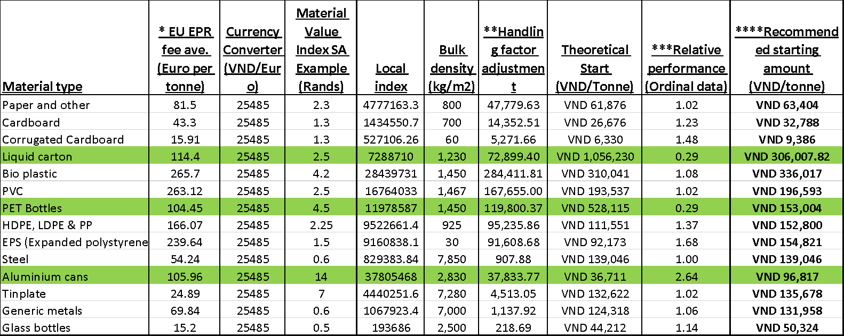
Can generate alternative Methodology of Calculation
DUMMY FIGURES JUST AS EXAMPLE

Slide 17
We applied 3 different methodologies – WORK IN PROGRESS
Fee per material (VND / Kg) | Methodology 1 F=(R*Q*P)+Fm (PROF L.T. HOA) | Methodology 2 Cost Based (C. DURANDT) | Methodology 3 Industry Best Practices (TetraPak et al.) | PROPOSAL
Paper/Carton |  |  |  | TBD
Beverage Carton | 750 |  | 700 | TBD
Glass | 140 | (96) 133 (160) |  | TBD
Aluminum | 600 |  |  | TBD
Iron | 350 |  |  | TBD
Tin |  |  |  | TBD
Rigid PET | 700/950 (transp./color) |  |  | TBD
Rigid PE, PS, PP |  |  |  | TBD
Rigid EPS, others,and multi-materials | 1400 |  |  | TBD
Rigid PVC | 3900 |  |  | TBD (harmful)
Flex Mono-material | 1900 |  |  | TBD
Flex Multi-material |  |  |  | TBD (switch to mono)
NOTES | + fix cost 10/20mio | Depends on recycling target

Slide 18
Three important recommendations
1. FEES MUST BE KEPT FLEXIBLE TO REVISED EVERY YEAR
Y0 fees must be fine-tuned once the system is tested
To be effective, the incentives must follow the volatility of global commodities market
(do not include in Decree, use a circular)
2. FEES MUST STUDIED TO INCENTIVIZE PRODUCERS’ INITIATIVE
VEPF fee > PRO fee
PRO fee + (fine) = VEPF fee
3. ECO-MODULATION CAN BE INSERTED (IN PHASE 2)
Fee +50%
Mixed materials
Full sleeve
Small litter-prone components (e.g. seal)
Non-plasma coatings & additives
Dark pigments
Hard to dissolve glue
Fee -50%
Use of Recycled or renewable materials
Gap big enough to incentivize Obliged Industry in self-organizing Producer Responsibility Organizations

Slide 19
Progressive roll-out of the EPR system (learning by doing)
2021 | Year 0 2022 | Year 1 2023 | Year 2 2024 | Onwards 2025+
Preparation | Set-up the system | Define the baseline | Start simple & focused | Extend
“Before EPR” Define the list of packaging materials Set theorical % for target recycling Set theorical fees by packaging material | “White Year” Obliged companies must: A) Register B) Report quantities C) Organize Producer Responsibility Organization(s) system | “Grey Year” Fees and targets are set at low level of the corridor No fines (assumptions are still to be confirmed, system still unstable) | “Start-up Year” Start full system | “Roll-out” Progressively extend to all packaging materials Introduce eco-modulation
 | SME temporarily exempted |  | SME Y0 (register & report) | SME in the system (VEPF or PRO option)

Slide 20
In addition, MONRE must give responsibilities across all the actors
All stakeholders must take responsibility and obligations, it is not just as a “Brand Owners” thing.
With the support of EPR investments:
Municipal Authorities must commit on progression of segregated collection. E.g. Germany started in 1990s focusing on making separate collection mandatory, Chile plan to cover 85% of population with separate collection by 2030, Korea local authorities created 759 MRF (material recovery facilities).
Distributors must create conditions. E.g. mandatory to provide segregated bins & collection for recycling systems from their premises
Informal sector shall be integrated in the system e.g. by registering to Women Unions and access grants
An output market for recycled materials must be created E.g. waste Companies must prove that x% of what is collected is recycled
AN IDEA: why not Collecting the fee at the origin? manufacturers, converters, importers of the material

