Slide 1

Discuss about Extended Producer Responsibility (EPR) for discarded products recycling
VAMA-VAMM, June-2021

Slide 2
Contents
Introduction of VAMA and VAMM
Background of EPR regulation in Vietnam
Proper Recycling system viewpoint
Concerns on Vietnam EPR System
Japan ELV recycling scheme
Proposal action plan

Slide 3
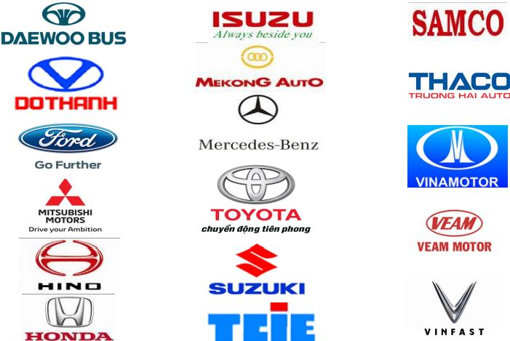
Introduction of VAMA
Introduction
Established on August 3, 2000.
No of members: 17 members
Mission and Purpose
To encourage the development and progress of the Vietnamese automotive industry
To represent and protect legal rights and interest of employees as well as employers in member enterprises of VAMA.
To ensure and improve legal rights and interest of vehicle users
To engage in automotive research and development programs as well as to ensure high environmental protection in Vietnam

Slide 4

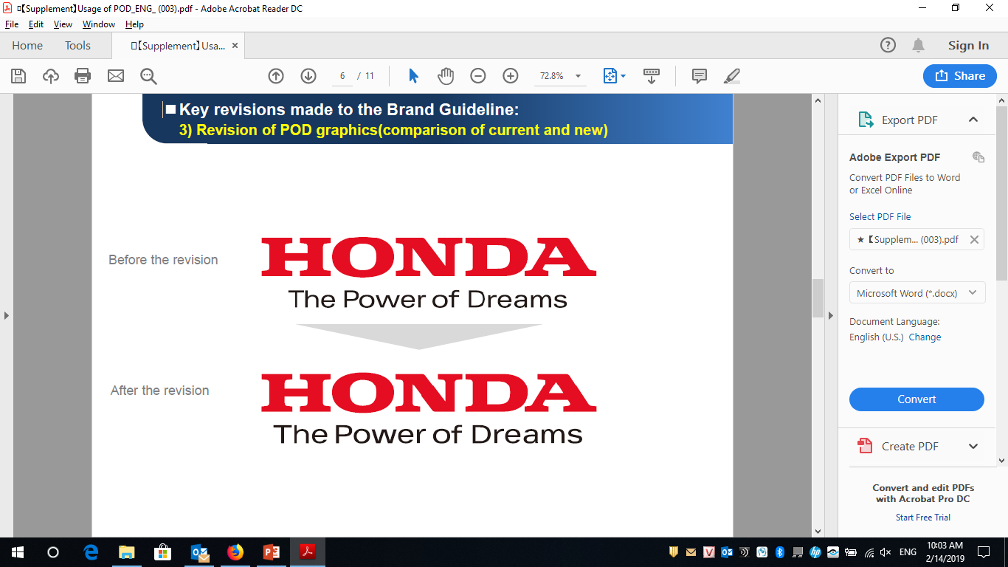




Mission & purpose of VAMM
Introduction of VAMM
Introduction
To be founded as Decision No. 996/QD-BNV issued on August 26, 2013, by Ministry of Internal Affairs allows the establishment of Vietnam Motorbike Manufacturers Association
No. of member: 05 members
No. | Name | Logo
1 | Honda Vietnam Co., Ltd.
2 | Piaggio Vietnam Co., Ltd.
3 | Suzuki Vietnam Co., Ltd
4 | Vietnam Manufacturing & Export Processing Company Limited (VMEP)
5 | Yamaha Motor Vietnam Co., Ltd
Building a forum to connect motorbike manufacturing enterprises in Vietnam
Contribute ideas to relevant agencies in completing the institutional and policy system related to the activities of the Association
Protecting legitimate rights and interests of members

Slide 5

Background of EPR regulation
Movement of Govt .
2013
2014
2015
11/2020
10/2021
2022
2023
2024
2025
Decision 50/2013/QĐ-TTg
Environment Law 55/2014/QH13
Decision
16/2015/QĐ-TTg
Environment Law 72/2020/QH14
Decree EPR
Approval
Guiding
circular
Apply for oil,
tire
Apply for
battery
Apply means of
transport
Producers’ responsibility
EPR Recycling | Applied products | Situation
Opt 1: Building recycling system and follow required mandatory recycling rate Opt 2: Financial contribution to Environment Fund |  | Recycling infrastructure not yet organized Unclear responsibility for User/ Recycler; Much burden on manufacturers responsibility Risk on the Fund management for wrong purposes
Concerns on roadmap:
Applying the law in 2025 is not suitable considering recycling current situation
It’s impossible to comply the law (mandatory rate issued by MONRE)
Protecting the environment must be balance between the regulation and manufacture’s ability
MONRE required VAMM/VAMA to support to build up appropriate regulation
VAMA, VAMM cooperate with MONRE to establish feasible roadmap with proper recycling system management

Slide 6
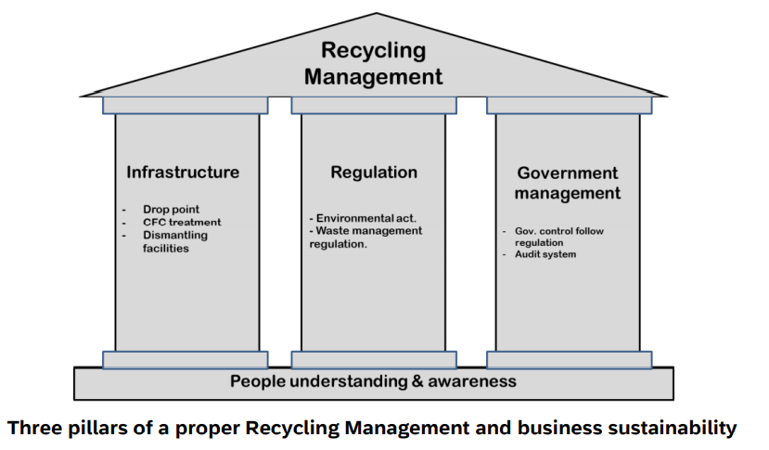
Proper Recycling Management System
VAMA and VAMM support discarded product Treatment/ Recycle regulation for Env & Health & Circular Economy in principle.
Biggest concern is “How to create well-management-system with all stakeholders”

Slide 7
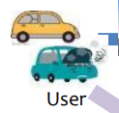
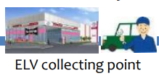
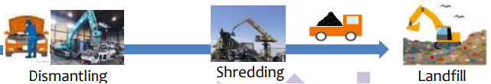
Concerns on EPR system in Vietnam
ELV’s recycling process flow
Vehicle owner
Makers
Infrastructure & recyclers
1
2
Concerns and solutions
1
Collection process
Concerns | GOVT | Makers | Users
Owner not bring ELV to collection point | - Regulation build up - Enforcement | Set up collection point (DLR net-work) Consider deposit scheme | Public awareness Compliance
Owner sell ELV to informal recycler | Regulation making Management & Penalty | X | X
2
Recycling process
Concerns | GOVT | Makers | Users
Informal sector to treat non-valued items incorrectly, cause harmful to envrmt. | - Regulation build - Enforcement | X | X
Technology of recyclers | - Standard build up -Encouragement | X | X

Slide 8
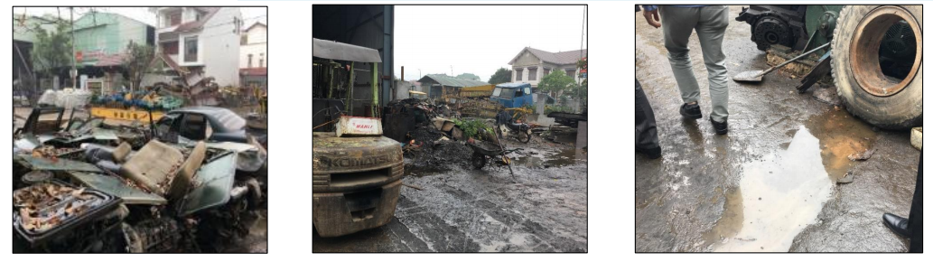
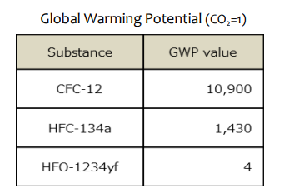

Example: Informal sectors/illegal dumping
“EPR System” cannot be effective without control informal sector by GOVT.
1/No proper environment treatment & protection
2/No air-conditioning gas collection → High Green-house - value

Slide 9
Overview of recycling situation in Vietnam
Vietnam current situation:
Informal sectors co-exists without environment friendly treatment.
Enforcement for owners to bring ELV vehicles to collection points
Network of standard and licensed recyclers is not popular

Slide 10
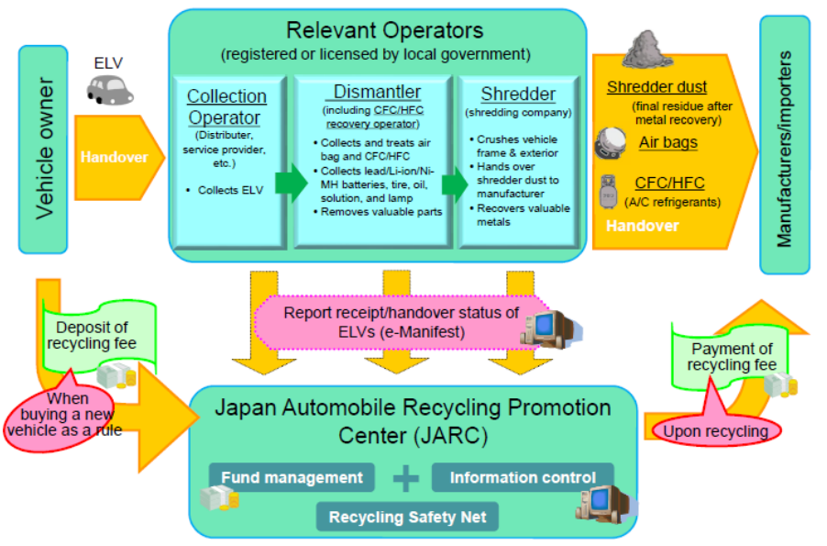
The ELV recycling system in Japan
Outline of Automobile Recycling Law

Slide 11
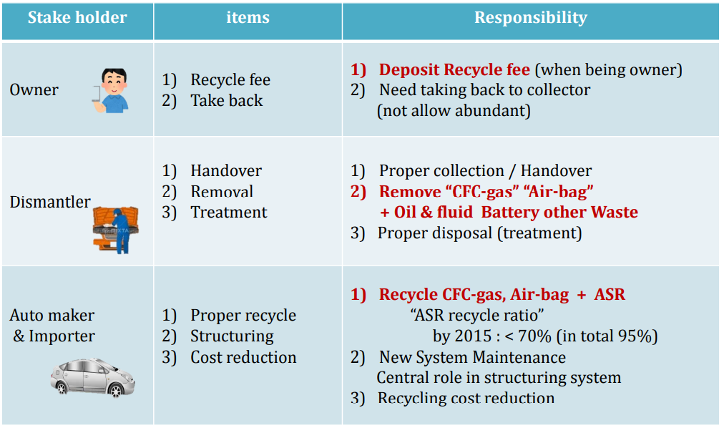
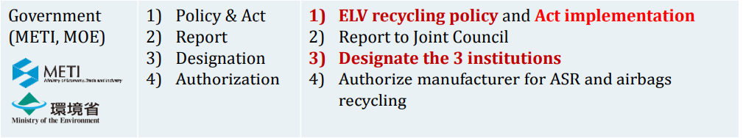
The ELV recycling system in Japan

Slide 12
Contents of Draft Decree EPR
Items | Concerns | Proposal
Recycling rate formular Ra = D x T x P Ra: actual recycling rate D: disposal coefficient (based on age of product) T: collection coefficient ( based on collection rate) P:recycling coefficient | The rate of disposal after the end of the life cycle or the consumer switching to a new product (D) need to be based on actual results, currently the Expert's proposal is not feasible. | Recycling rate to be issued after VAMA and VAMM’s pilot project results.
EPR Management system | The responsibility allocation system is not clear. Automotive and Motor sector have compilated supplier chain with different production. | To provide “ Guidelines” to make clear EPR allocation system.

Slide 13
Contents of Draft Decree EPR
Items | Concerns | Proposal
F = R x V x Fs + Fm F : financial contribution for a specific product R: compulsory recycling rate V : volume of products distributed to market in year Fs : standard recycling cost (based on the average value of at least 3 levels of recycling costs announced by 3 recyclers with different recycling technologies for products and packages. Fm: Operation cost of EPR system management (Fm = 3% x R x V x Fs) | Fs is not reasonable because the concept of “3 recycling facilities with different recycling technologies” is not specific. It is possible that the quotation of the cost of 1 unit is too different. | To regulate and changed to “ 3 standard and lowest cost recycling facilities”

Slide 14
VAMA & VAMM’s master plan aligned with MONRE’s plan
Objectives: To collaborate with Govt. in establishing proper recycling regulation to dismiss impacts on environment and preserve natural resources, harmonize benefits of Govt, public and Industry (VAMA-VAMM)
 | 2019 | 2020 | 2021 | 2022 | 2023 | 2024 | 2025
Central Gov.
VAMM/VAMA
Draft of revised law
Submit and get approval for the law
Make draft and get approval for decree
Law and decree effective
Apply for oil, tire
Apply for battery
Apply for means of transport
Draft and get approval for circular
National EPR Council evaluate and adjust the recycling rate and financial contribution
Purpose:
Decision 16 not effective
➔ revise the law
Purpose: Require EPR with mandatory recycling rate
and contribution to Fund
Purpose: Issue formula of recycling rate and financial contribution
Purpose: Issue recycling rate and financial contribution
Comment and petition to draft revised law to build up appropriate regulations
Comment and petition to draft decree
Establish collection points
Study actual consider demo- collection and recycling
Propaganda
VAMM is authorized to collect and recycle motorbikes
VAMA is authorized to collect and recycle cars
Follow the law
Study to build up appropriate recycling rate, contribution fee and recycling method
Co-with MONRE to establish recycling network
Support MONRE to propose a proper recycling rate and financial amount contribution to Environment Fund
Request MONRE to join the pilot project to recover and recycle ELV products to give out proper recycling rate
Propose participants and responsibilities of manufacturers and importers in National EPR Council

Slide 15

Thank you

